Slide 1

Continuous Program Improvement for Accreditation
Peter Ostafichuk,
Mechanical Engineering, UBC
March 26, 2012
Simon Fraser University

Slide 2
12 Graduate Attributes
Knowledge base for engineering
Problem analysis
Investigation
Design
Use of engineering tools
Individual and team work
Communication skills
Professionalism
Impact on society and environment
Ethics and equity
Economics and project management
Lifelong learning

Slide 3
Objectives
Define terminology used in Graduate Attribute assessment
Outline a framework for program-wide improvement process
Describe methods and tools that can be used in the assessment process

Slide 4
Engineering Graduate Attribute Development (EGAD) Project
Developing resources and training for faculty and administration on continuous program improvement processes
Composed of engineering educators and educational developers across Canada, and sponsored by deans of engineering (NCDEAS)
Working collaboratively with CEAB

Slide 5
Disclaimers
EGAD ≠ CEAB
Examples from other schools will be presented – these are only intended to demonstrate some possible approaches
I will share my experiences - yours may be (will be?) different

Slide 6
Material from this workshop
Slides and online resources are posted on the EGAD website http://egad.engineering.queensu.ca
More detail at the end of the session
Feel free to ask questions throughout the session

Slide 7
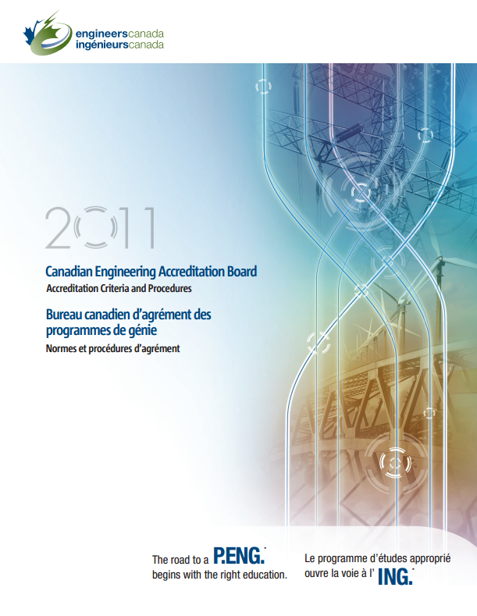
Context: CEAB Criterion 3.1 & 3.2
3.1: Graduates of a program possess the 12 attributes
3.2: Continual program improvement processes in place using results of graduate attribute assessment

Slide 8
Context: CEAB Compliance
“While programs are expected to provide evidence to demonstrate compliance with this criterion, a transition and development period will be allowed. Starting in June 2015, the Accreditation Board will make decisions about compliance with the Graduate Attribute criteria. Deficiencies may be assessed in cases of non-compliance.”

Slide 9
International agreement for outcomes assessment
Accreditation bodies in countries who are signatories to the Washington Accord use outcomes-based assessment
Washington Accord allows substantial equivalency of graduates from:
  Australia  Canada  Chinese Taipei
  Hong Kong  Japan  Korea
  New Zealand  Rep. Ireland  Singapore
  South Africa  UK  United States

Slide 10
Starting point:
We’re starting from the question
“How do we create a process to improve our program that demonstrates what our students can do?”

Slide 11
Graduate Attribute Assessment
Outcomes based: In general, the term outcomes assessment is used to answer questions like:
  What can students do?
  How does their performance compare to our stated expectations?
It identifies gaps between
our perceptions of what we teach |  | actual knowledge, skills, and attitudes students develop program-wide.

Slide 12
Inputs and Outcomes
Inputs Course materials (text, notes) Student pre-university background Faculty education, professional status Ongoing faculty development Class sizes Content Campus resources Contact hours Laboratory equipment Support services | Outcomes Demonstrated abilities (cognitive, skills, attitudes)

Slide 13
Inputs and Outcomes
Inputs Course materials (text, notes) Student pre-university background Faculty education, professional status Ongoing faculty development Class sizes Content Campus resources Contact hours Laboratory equipment Support services | Outcomes Demonstrated abilities (cognitive, skills, attitudes)
Current CEAB Accreditation System
Remains in place (for foreseeable future)
Graduate Attributes Accreditation
Emphasis on continuous program improvement
Graduate Attributes Accreditation

Slide 14
General advice
Capitalize on what you're already doing
Start from the question “what do we want to know to improve our program”, rather than “what does CEAB want us to do”
Don't generate reams of data that you don't know what to do with: create information, not just data

Slide 15
Program-wide assessment process flow
Create a Program
Improvement Plan
Program & Course
Improvement
Defining Purpose
and Outcomes
Analysis and
Interpretation
Stakeholder input
Identifying and Collecting Data
Program Mapping
(Identifying
Assessment Points)

Slide 16
Program-wide assessment process flow
Create a Program
Improvement Plan
Program & Course
Improvement
Defining Purpose
and Outcomes
Analysis and
Interpretation
Stakeholder input
Identifying and Collecting Data
Program Mapping
(Identifying
Assessment Points)

Slide 17
Purpose and Outcomes
What do you want your program to be known for?
12 Graduate Attributes defined by CEAB:
  Characteristics of a graduating engineer
  A broad ability or knowledge base to be held by graduates of a given undergraduate engineering program
CEAB Graduate Attributes must be addressed, but programs are free to add/emphasize as they want (e.g. leadership, creative thinking, design, entrepreneurship, etc.)

Slide 18
How do we assess:
Knowledge base for engineering
Problem analysis
Investigation
Design
Use of engineering tools
Individual and team work
Communication skills
Professionalism
Impact on society and environment
Ethics and equity
Economics and project management
Lifelong learning

Slide 19
E.g. assess lifelong learning
Lifelong learning
An ability to identify and address their own educational needs in a changing
world in ways sufficient to maintain their competence and to allow them to
contribute to the advancement of knowledge
Can this be directly
measured?
Would multiple
assessors be consistent?
Would assessments
be meaningful?
Probably not, so more specific measurable indicators are needed.
This allows the program to decide what is important
Notes:
Given the amount of uncertainty about what this means, I would bet that we would have little consistency if we were to try to measure this attribute directly.

Slide 20
Indicators: examples
Lifelong learning
An ability to identify and address their own educational needs in a changing
world in ways sufficient to maintain their competence and to allow them to
contribute to the advancement of knowledge
Graduate
attribute
The student:
Critically evaluates information
for authority, currency, and
objectivity when referencing
literature.
Identifies gaps in knowledge and
develops a plan to address
Indicators
Describes opportunities for future
professional development.
Uses information ethically and legally
to accomplish a specific purpose
Notes:
I changed performance indicators to Indicators
BTW one of the critical indicators of a student’s ability to engage in Lifelong Learning is their ability to identify gaps in their knowledge and skill sets and create a plan to address them

Slide 21
Indicators: examples
Lifelong learning
An ability to identify and address their own educational needs in a changing
world in ways sufficient to maintain their competence and to allow them to
contribute to the advancement of knowledge
Graduate
attribute
The student:
Critically evaluates information
for authority, currency, and
objectivity when referencing
literature.
Identifies gaps in knowledge and
develops a plan to address
Descriptors of what students must do to be considered competent in an attribute; the measurable and pre-determined standards used to evaluate learning.
Indicators
Describes opportunities for future
professional development.
Uses information ethically and legally
to accomplish a specific purpose
Notes:
I changed performance indicators to Indicators
BTW one of the critical indicators of a student’s ability to engage in Lifelong Learning is their ability to identify gaps in their knowledge and skill sets and create a plan to address them

Slide 22
Establishing Indicators
Level of expectation
(“describes”, “compares”, “applies”, “creates”, etc.)
Content area
Critically evaluates information for authority, currency, and
objectivity in reports.
context
A well-written indicator includes:
  what students will do
  the level of complexity at which they will do it
  the conditions under which the learning will be demonstrated

Slide 23
Indicators
Question: For Attribute #3 (Investigation), which of the following potential indicators are appropriate?
Complete a minimum of three physical experiments in each year of study.
Develop an experiment to classify material behaviour as brittle, plastic, or elastic.
Design investigations involving information and data gathering, analysis, and/or experimentation
Learn the safe use of laboratory equipment.

Slide 24
Developing Indicators Using Taxonomies
Taxonomy: a classification of learning objectives
  e.g. Bloom’s Taxonomy, procedural taxonomies, Fink’s Taxonomy of Significant Learning, etc.
Used to categorize the type and depth of learning
Helpful for writing effective indicators and assignments

Slide 25
Bloom’s Taxonomy
Bloom’s (cognitive)
Bloom’s (affective)
Remembering/Knowing
(list, describe, name)
Receiving
(asks, describes, points to)
Understanding
(explain, summarize, infer)
Responding
(answers, performs, practices)
Applying
(use in new situation)
Valuing
(demonstrates belief in, sensitive to)
Analyzing
(compare, organize, differentiate)
Organizing
(relates beliefs, balances)
Evaluating/Synthesizing
(critique, judge, justify decision)
Internalizing
(acts, shows, practices)
Creating
(design, construct, generate ideas)
Anderson, L. W. and David R. Krathwohl, D. R., et al (Eds..) (2001) A Taxonomy for Learning, Teaching, and Assessing: A Revision of Bloom's Taxonomy of Educational Objectives

Slide 26
Procedural Taxonomy
Miller’s Pyramid (clinical practice) | Engineering Practice Levels (McCahan and Romkey)
Knows how | Describe – be able to describe the process or practice
 | Comprehend -- be able to explain the process or practice
Shows how | Demonstrate – be able to demonstrate the process or practice when cued.
 | Select and Combine – be able to select appropriate processes or practices and combine them
Does | Naturalize -- be able to use a variety of processes as a natural part of practice.

Slide 27
E.g.: Design Attribute (UBC, adapted from Queens)
Indicator Title | Indicator Description
4.1 Use of Process | Adapt and apply general design process to design system, component, or process to solve open-ended complex problem.
4.2 Need and Constraint Identification | Identify customer, user, and enterprise needs, and applicable constraints
4.3 Problem Specification | Specify design requirements based on needs and constraints
4.4 Solution Generation | Produce a variety of potential design solutions suited to meet functional specifications
4.5 Solution Evaluation | Perform systematic evaluations of the degree to which several design concept options meet project criteria
4.6 Detailed Design | Apply appropriate engineering knowledge, judgement, and tools, in creating and analyzing design solutions
4.7 Solution Assessment | Assess design performance based on requirements, needs, and constraints

Slide 28
E.g. leveled indicators by changing verbs and context (Queen’s)
Follow a provided design process to design system, component, or process to solve an open-ended complex problem as directed by a mentor.
Employ and apply design processes and tools with emphasis on problem definition, idea generation and decision making in a structured environment to solve a multidisciplinary open-ended complex problem.
Applies specified disciplinary technical knowledge, models/simulations, and computer aided design tools and design tools in a structured environment to solve complex open-ended problems
Selects, applies, and adapts disciplinary technical knowledge and skills and design concepts to solve a complex client-driven open-ended problems

Slide 29
E.g. leveled indicators by changing verbs and context (Queen’s)
Follow a provided design process to design system, component, or process to solve an open-ended complex problem as directed by a mentor.
Employ and apply design processes and tools with emphasis on problem definition, idea generation and decision making in a structured environment to solve a multidisciplinary open-ended complex problem.
Applies specified disciplinary technical knowledge, models/simulations, and computer aided design tools and design tools in a structured environment to solve complex open-ended problems
Selects, applies, and adapts disciplinary technical knowledge and skills and design concepts to solve a complex client-driven open-ended problems

Slide 30
E.g.: Communication Attribute (UofT)
1. Ability to identify and credibly communicate engineering knowledge
Situate, in document or presentation, the solution or design in the world of existing engineering, taking into account social, environmental, economic and ethical consequences Recognize a credible argument (reading) Construct a credible argument in written or spoken form – to persuasively present evidence in support of a claim Organize written or spoken material– to structure overall elements so that their relationship to a main point and to one another is clear Create “flow” in document or presentation – flow is a logical progression of ideas, sentence to sentence and paragraph to paragraph
2. Ability to incorporate visual elements in communication
Incorporate visual material that enhances communication without detracting from it Incorporate various media appropriately Incorporate principles of visual design appropriately
3. Ability to develop communication through an iterative process
Use iteration to clarify and amplify understanding of issues being communicated Use reflection to determine and guide self-development
Choose x of 5 from domain 1
Choose y of 3 from domain 2
Choose z of 2 from domain 3

Slide 31
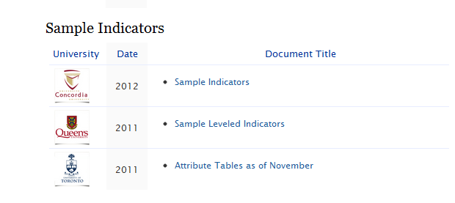
Sample indicators
EGAD website has sample draft indicators from some programs, and links to other examples under “Additional Resources” page
http://egad.engineering.queensu.ca

Slide 32
Implications
Attributes are specified by CEAB but indicators are defined by programs
Leads to divergence in indicators between programs (i.e. no single list, though programs are sharing their indicators on the EGAD website)
Opportunity for programs to customize and differentiate

Slide 33
Summary: Program objectives
Ask: What are your program strengths and objectives?
Need to determine / define the indicators used to demonstrate the Graduate Attributes.
Consider how the program-level attributes / indicators relate to individual course-level learning objectives.
Questions/comments?

Slide 34
Program-wide assessment process flow
Create a Program
Improvement Plan
Program & Course
Improvement
Defining Purpose
and Outcomes
Analysis and
Interpretation
Stakeholder input
Identifying and Collecting Data
Program Mapping
(Identifying
Assessment Points)

Slide 35
Program mapping
Where are attributes
developed?
Where are attributes
assessed?
Usually a program would:
  Conduct surveys or formal mapping exercises to determine where attributes are being developed
  Identify/select courses used to assess attributes

Slide 36
Assessment mapping
Not required to assess every student
  Graduate Attributes is not a “minimum path” assessment
  Not required to track individual students
  Can use sampling to gather representative data
Not required to develop or assess in every course
Not required to develop or assess in every year

Slide 37
Curriculum Mapping
Mapping software
  Kuali (open source, http://www.kuali.org/)
  U Guelph developing Currickit (http://currickit.wikispaces.com/)
Surveys
  CDIO: Introduced, Developed, or Utilized (ITU)
  Custom survey (e.g. UBC Grad Attribute survey, http://tinyurl.com/EGADSurvey)
Informal discussions

Slide 38
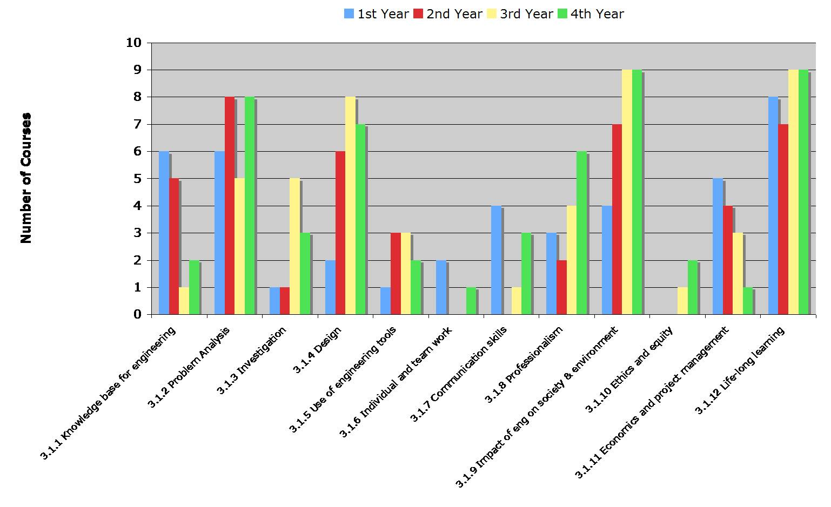
Example: ITU Analysis (UofC)
ITU = Introduce, Teach, Utilize.
Chart above: number of courses in which each graduate attribute is Introduced.

Slide 39
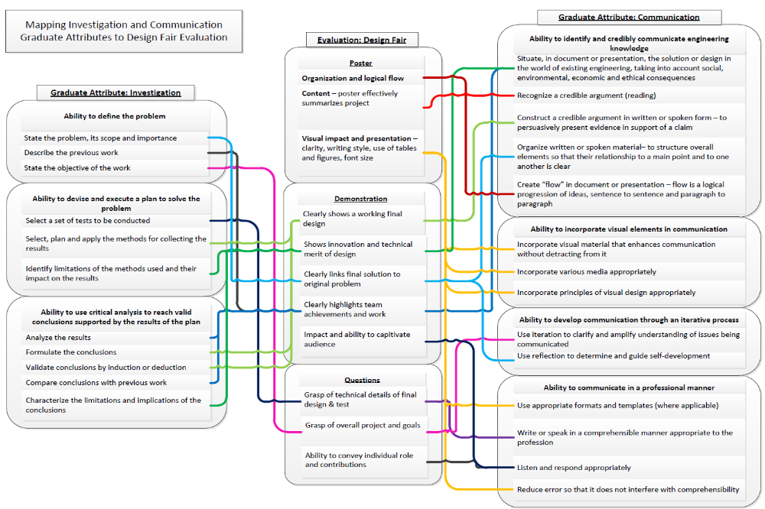
Example: Mapping to Assessments (UofT)

Slide 40
Example: Mapping to Courses (UBC)
 |  | 1 | 2 | 3 | 4 | 5 | 6 | 7 | 8 | 9 | 10 | 11 | 12
Course | Number | Knowledge Base | Problem Analysis | Investigation | Design | Engineering Tools | Individual / Team Work | Communication | Professionalism | Impact of Engineering | Ethics / Equity | Econ. / Project Management | Life-long Learning
APSC | 150 | I | I |  | I | I | I |  | I | U | I |  | I
MATH | 100 | E | U | I |  |  |  | U |  | I |  |  | I
MATH | 101 | E | U | I |  |  |  | U |  | I |  |  | I
MATH | 152 | E | I | E |  | E |  |  |  |  |  |  | I
PHYS | 153 | E | E | E | I | I | E | U | U | U | U | I | U
PHYS | 170 | E | E | U | I | U | I | I
APSC | 201 | U | E | U | U | U | E | E | E |  | E | I | U
MATH | 253 | E | E | I | E |  | I | U |  | I | U |  | U
MATH | 256 | E | E | U | I | I
MECH | 220 | E | I | U | U | E | U | I | I | I | I |  | I
MECH | 221 | E | E | E | I | E | U | U | I | I | I |  | I
MECH | 222 | E | E | E | U | E | U | U | I | I | I | I | I
MECH | 223 | E | E | E | E | E | E | U | U | E | I | E | I
I | Introduced | U | Utilized | E | Emphasized

Slide 41
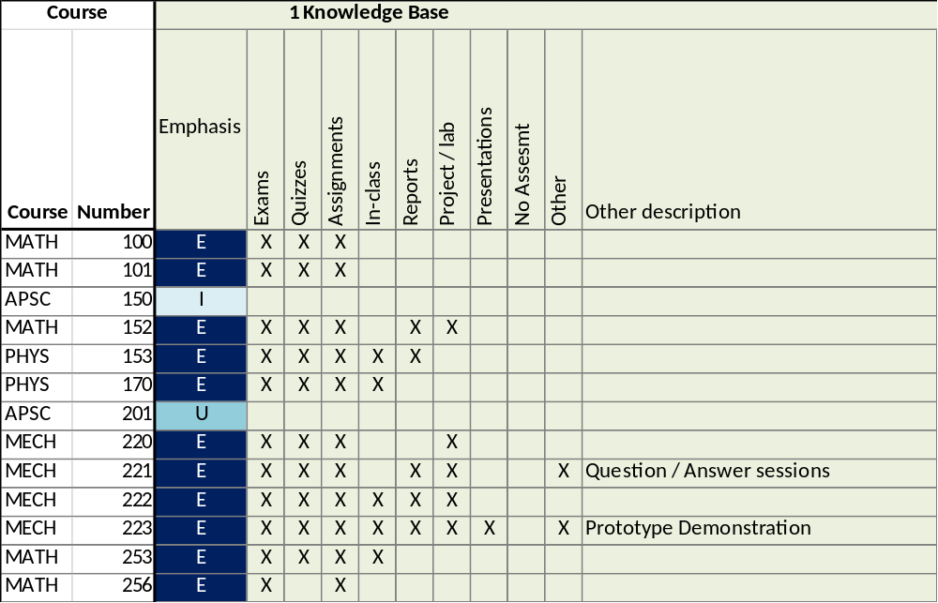
Assessment Mapping to Courses (UBC)

Slide 42
Summary: Program Mapping
Determine where and when in the program students develop attributes and students are assessed on the attributes
Curriculum mapping tables allow planning
Questions/comments?

Slide 43
Program-wide assessment process flow
Create a Program
Improvement Plan
Program & Course
Improvement
Defining Purpose
and Outcomes
Analysis and
Interpretation
Stakeholder input
Identifying and Collecting Data
Program Mapping
(Identifying
Assessment Points)

Slide 44
Why not use grades to assess outcomes?
How well does the program prepare
students to solve open-ended
problems?
Student transcript
Electric Circuits I Electromagnetics I Signals and Systems I Electronics I Electrical Engineering Laboratory Engineering Communications Engineering Economics ... Electrical Design Capstone | 78 56 82 71 86 76 88 86
Are students prepared to continue
learning independently after
graduation?
Do students consider the social
and environmental implications of
their work?
Course grades usually aggregate
assessment of multiple objectives,
and are indirect evidence for
some expectations
What can students do with
knowledge (plug-and-chug vs.
evaluate)?

Slide 45
Assessment Tools
How to measure learning against specific expectations?
Direct measures – directly observable or measurable assessments of student learning
  E.g. Student exams, reports, oral examinations, portfolios, concept inventories etc.
Indirect measures – opinion or self-reports of student learning or educational experiences
  E.g. grades, surveys, focus group data, graduation rates, reputation, etc.

Slide 46
Some Assessment Tools
Local written exam
(e.g. question on final)
External examiner
(e.g. Reviewer on design projects)
Standardized written exam
(e.g. Force concept inventory)
Oral exam
(e.g. Design projects presentation)
Performance appraisal
(e.g. Lab skill assessment)
Oral interviews
Simulation
(e.g. Emergency simulation)
Surveys and questionnaires
Behavioural observation
(e.g. Team functioning)
Focus group
Portfolios
(student maintained material)
Archival records
(registrar's data, records, ...)

Slide 47
Selecting Assessments
Looking for assessments that are:
  Valid: they measure what they are supposed to measure
  Reliable: the results are consistent; the measurements are the same when repeated with the same subjects under the same conditions
Capitalize on what you are already doing
Look for “leading Indicators”
Consider standardized tests and inventories, embedded questions, and rubrics

Slide 48
Examples: Standardized Tests and Embedded Questions
Record and track grade elements separately for assessments such as:
  Force Concept Inventory (FCI) before and after course in mechanics to assess conceptual understanding (part of physics knowledge base)
  Questions on a math midterm that specifically target elements of problem solving
  Various knowledge / skills assessed as part of a design course final exam (e.g. design process, problem identification, project management, professionalism, team function, etc.)
Notes:
48

Slide 49
Rubrics
Dimensions (Indicator) | Scale (Level of Mastery)
 | Not demonstrated | Marginal | Meets expectations | Exceeds expectations
Indicator 1
Descriptor 1a
Descriptor 1b
Descriptor 1c
Descriptor 1d
Indicator 2
Descriptor 2a
Descriptor 2b
Descriptor 2c
Descriptor 2d
Indicator 3
Descriptor 3a
Descriptor 3b
Descriptor 3c
Descriptor 3d
Reduces variations between grades (increase reliability)
Describes clear expectations for both instructor and students (increase validity)

Slide 50
 | 1 (not demonstrated) | 2 (marginal) | 3 (meets expectations) | 4 (outstanding) | Mark
Gathers information from appropriate sources 3.04-FY4: Gathers info | No significant information used, not cited; blatant plagiarism. | Insufficient usage; improper citations. | Gathers and uses information from appropriate sources, including applicable standards, patents, regulations as appropriate, with proper citations | Uses information from multiple authoritative, objective, reliable sources; cited and formatted properly | /4
Plans and manages time and money 3.11-FY1: Manage time and money | No useful timeline or budget described; poorly managed project; safety issues | Poor timeline or budget; infrequent meetings; minor safety problems | Plans and efficiently manages time and money; team effectively used meetings; safety considerations are clear | Efficient, excellent project plan presented; detailed budget; potential risks foreseen and mitigated | /4
Describes design process 3.04-FY1: Uses process | No discussion of design process. | Generic design process described. | Describes design process used to design system, component, or process to solve open-ended complex problem. | Comprehensive design process described, with appropriate iterations and revisions based on project progress | /4
Incorporates social, environmental, and financial factors 3.09-FY4: Sustainability in decisions | No consideration of these factors. | Factors mentioned but no clear evidence of impact on decision making. | Incorporated appropriate social, environmental, and financial factors in decision making | Well-reasoned analysis of these factors, with risks mitigated where possible | /4
Demonstrates appropriate effort in implementation | Insufficient output | Sufficient implementation but some opportunities not taken, or feedback at proposal not incorporated in implementation | Appropriate effort, analysis, and/or construction demonstrated to implement product, process, or system | Outstanding implementation | /4
Compares design solution against objectives 3.04-FY7: Compares solution | No evaluation of design solution | Some factors missed in evaluating design solution | Compares the design solution against the project objectives and functional specifications, providing qualitative evaluation where appropriate | Comprehensive evaluation of design solution, with well-defended recommendations for future work or implementation | /4
Creates report following requirements | Poorly constructed report | Some organization problems, minor formatting problems, redundancy, spelling grammar/errors | Report achieves goal using formal tone, properly formatted, concisely written, appropriate use of figures, few spelling/grammar errors | Professional tone, convincing argument, authoritative, skillful transitions | /4
Overall Grade: |  |  |  |  | /28
Sample Rubric (Queens)
threshold
target

Slide 51
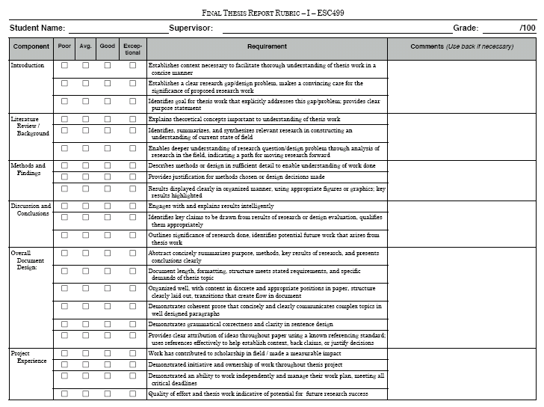
Mapping Indicators to Existing Evaluation (UofT)
1. Ability to define the problem
State the problem, its scope and importance Describe the previous work State the objective of the work
1. Ability to identify and credibly communicate engineering knowledge
Situate, in document or presentation, the solution or design in the world of existing engineering, taking into account social, environmental, economic and ethical consequences Recognize a credible argument (reading) Construct a credible argument in written or spoken form – to persuasively present evidence in support of a claim Organize written or spoken material– to structure overall elements so that their relationship to a main point and to one another is clear Create “flow” in document or presentation – flow is a logical progression of ideas, sentence to sentence and paragraph to paragraph

Slide 52
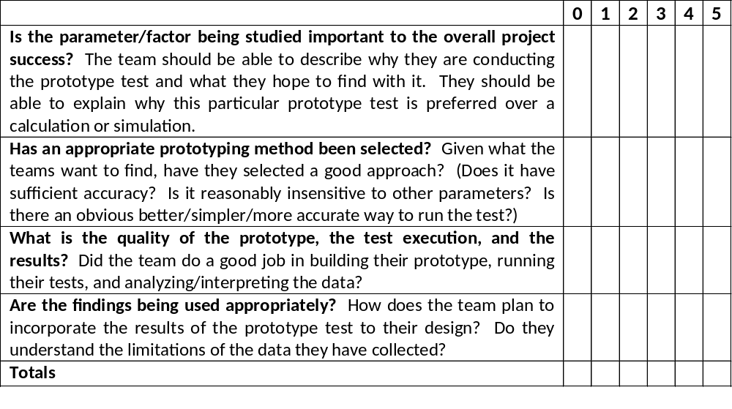
Old Evaluation Form (UBC)

Slide 53
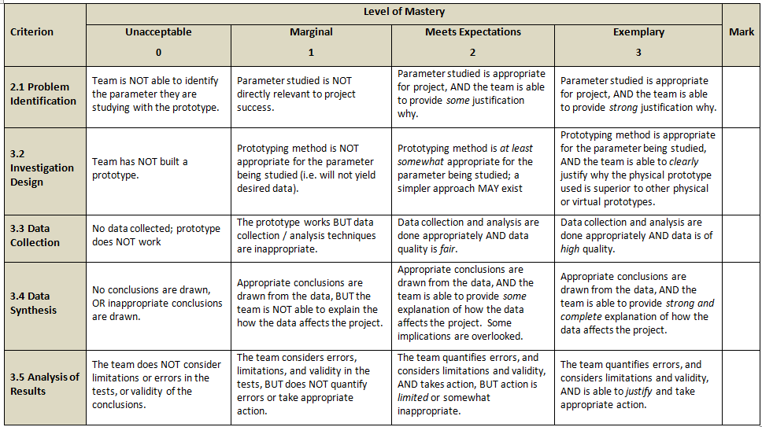
New Prototype Evaluation Rubric

Slide 54
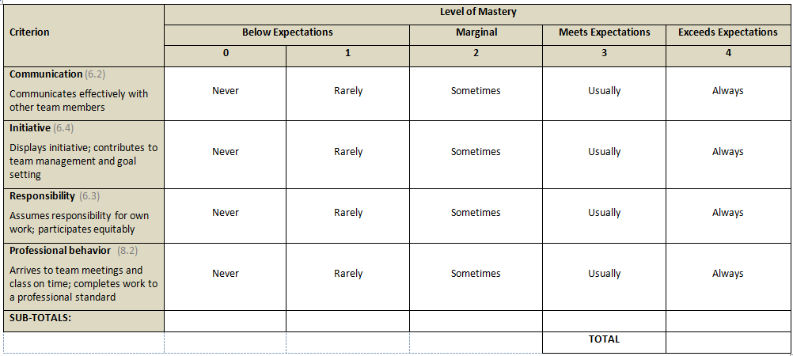
Peer Evaluation Rubric

Slide 55
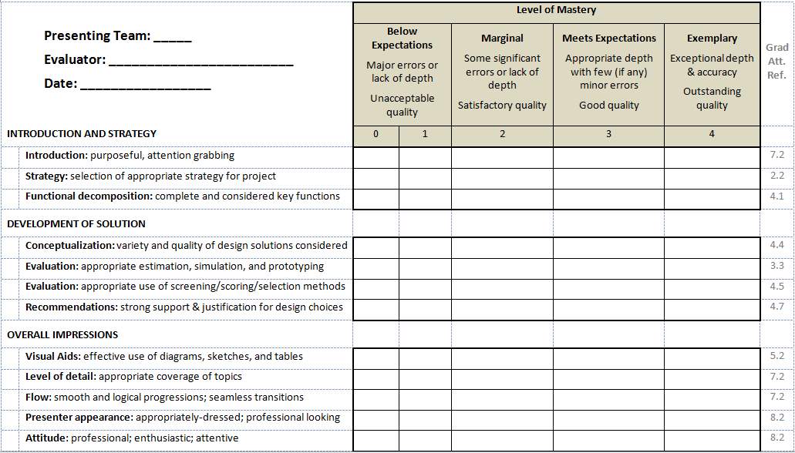
Presentation Evaluation Rubric (UBC)

Slide 56
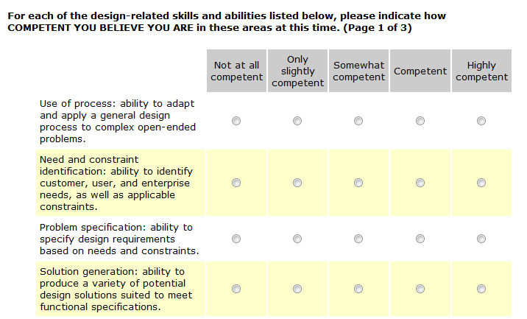
Student Survey (UBC)

Slide 57
Summary: Assessments
Determine how indicators will be assessed (reports, presentations, observation, etc.)
Direct assessment and indirect assessment can be useful
Rubrics can help to increase reliability and validity
Consider embedded questions
  Set tests, exams, quizzes, etc. such that specific questions are linked to specific indicators
  Record marks separately by question

Slide 58
Program-wide assessment process flow
Create a Program
Improvement Plan
Program & Course
Improvement
Defining Purpose
and Outcomes
Analysis and
Interpretation
Stakeholder input
Identifying and Collecting Data
Program Mapping
(Identifying
Assessment Points)

Slide 59
Now that we have data… analyze and evaluate
Organize data in a meaningful way that allows you to identify strengths, trouble spots, trends,…
Not a “checklist” or “hoop jumping” exercise
Look for how many students are meeting program expectations
Look for validity and reliability in your assessments
Some examples…

Slide 60
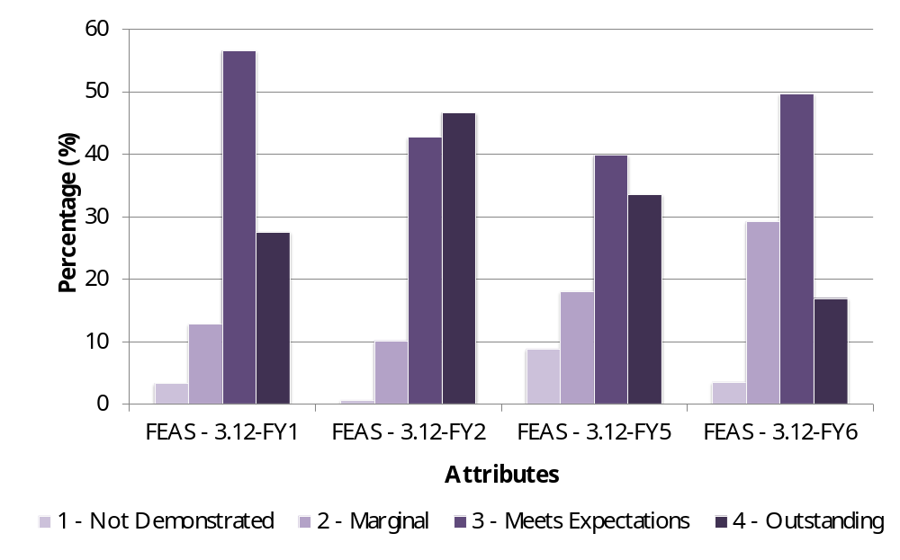
Histograms for Lifelong learning (Queens)
3.12-FY1 | Uses information effectively, ethically, and legally to accomplish a specific purpose, including clear attribution of Information sources.
3.12-FY2 | Identifies a specific learning need or knowledge gap.
3.12-FY5 | Identifies appropriate technical literature and other information sources to meet a need
3.12-FY6 | Critically evaluates the procured information for authority, currency, and objectivity.

Slide 61
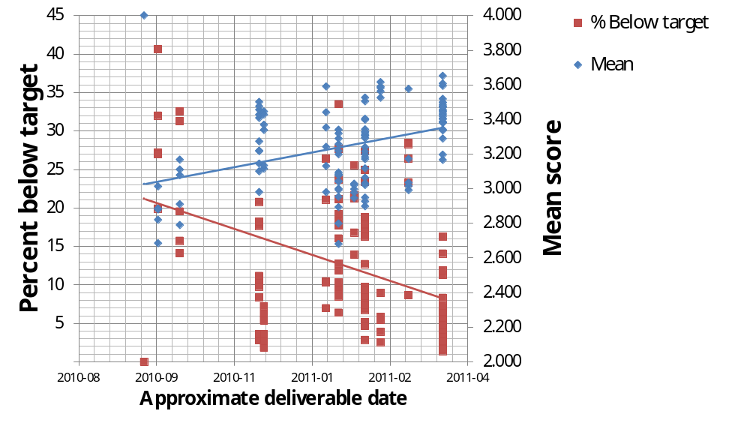
Could look for trends over time (Queens)

Slide 62
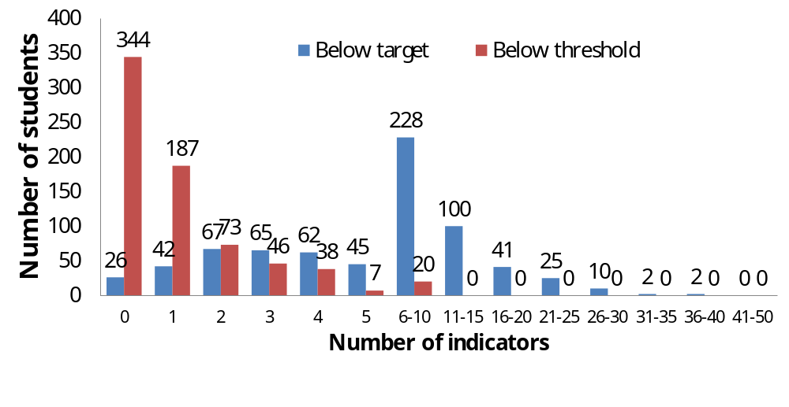
Could look at performance by student (Queens)

Slide 63
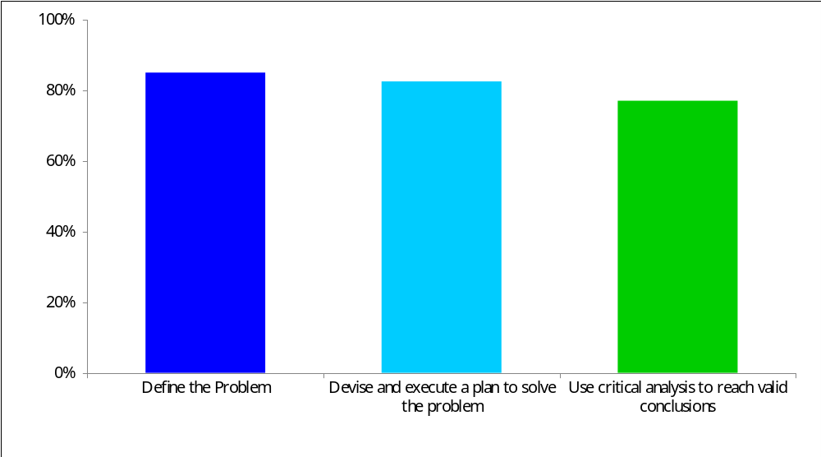
Histogram for Communication (UofT)
Percentage of students who meet or exceed performance expectations in indicators

Slide 64
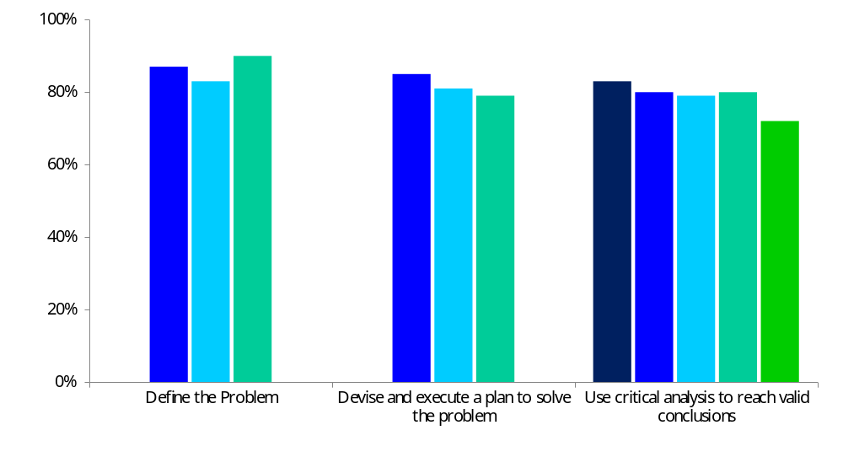
Histogram for Communication (UofT)
Percentage of students who meet or exceed performance expectations in indicators

Slide 65
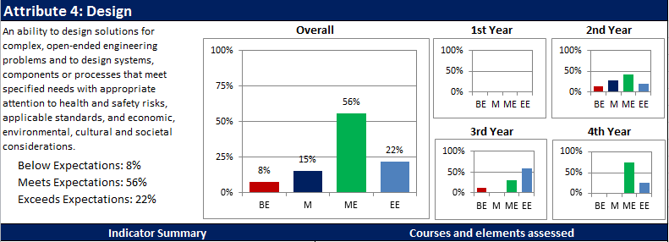
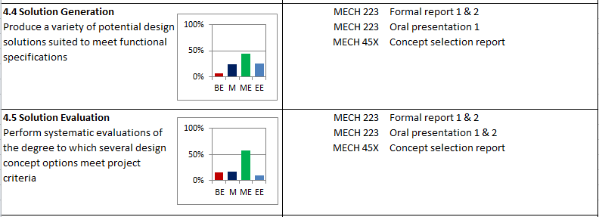
Histograms / Summary for Design (UBC)

Slide 66
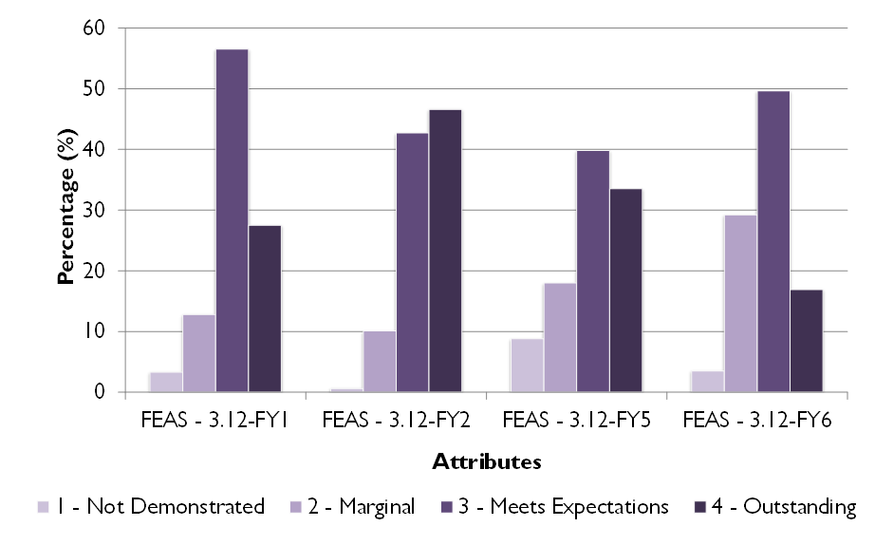
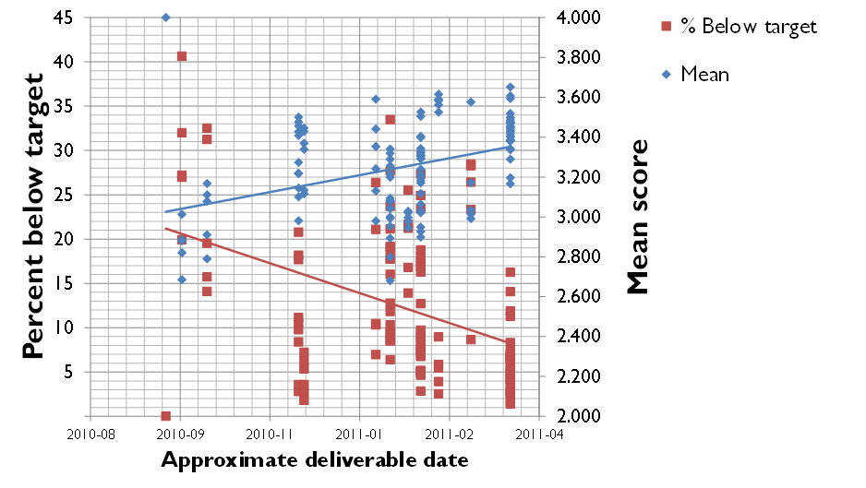
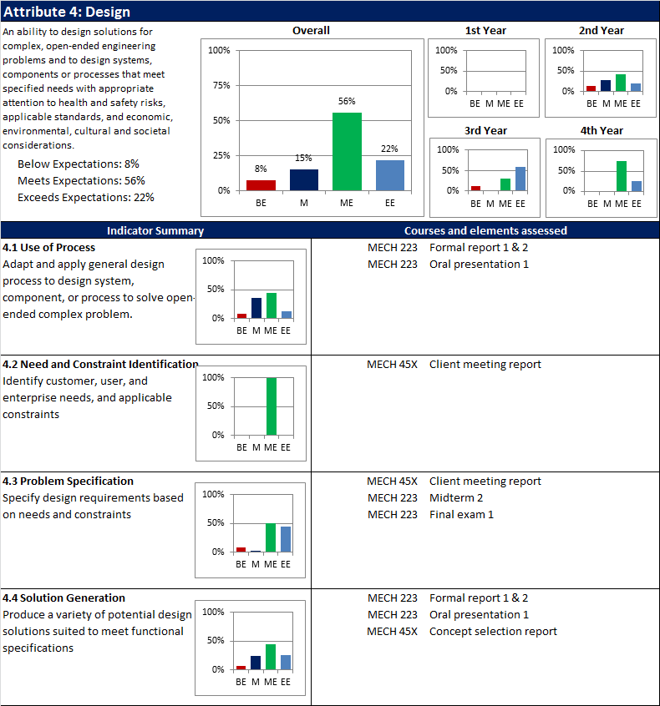
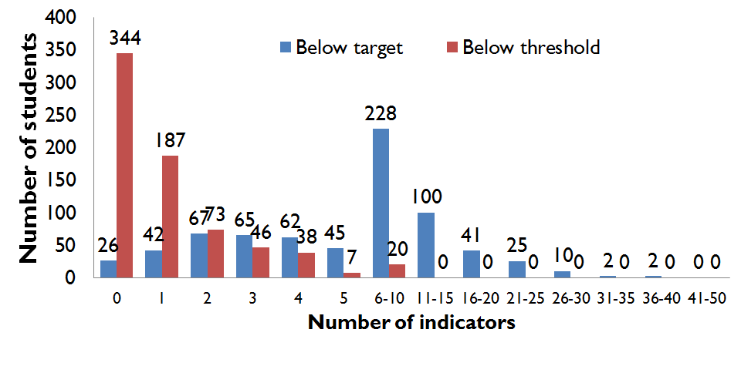
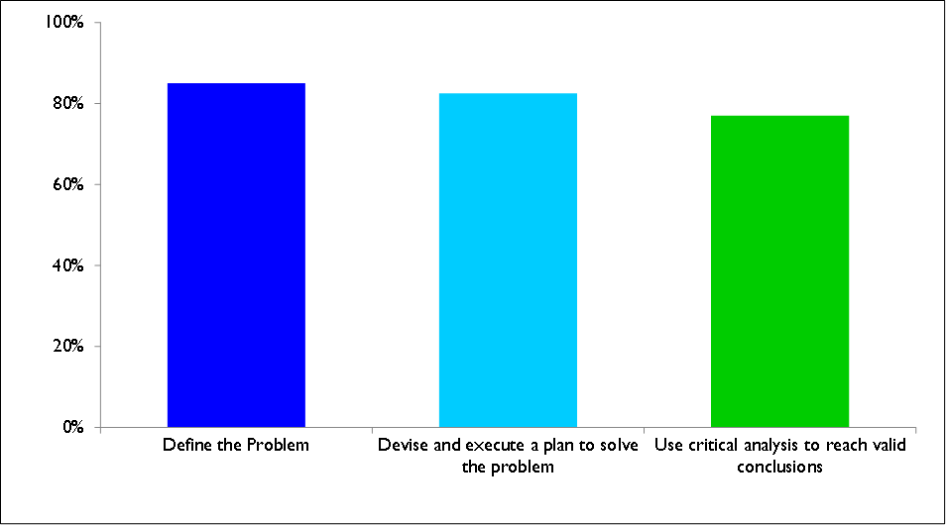
Summary: Analysis and interpretation
Present data in a way that is meaningful and useful to you

Slide 67
Summary: Analysis and interpretation
Use measured data to evaluate how well students are meeting expectations
Consider how valid and reliable data is
Look for strengths, weaknesses, trends,…
Questions/comments?

Slide 68
Program-wide assessment process flow
Create a Program
Improvement Plan
Program & Course
Improvement
Defining Purpose
and Outcomes
Analysis and
Interpretation
Stakeholder input
Identifying and Collecting Data
Program Mapping
(Identifying
Assessment Points)

Slide 69
Schedule Options
Collect data every year as part of normal course operation, assess at regular intervals
Staggered multi-year cycle
  Year 1: Gather data on 4 attributes (Group A)
  Year 2: Analyze data on Group A, gather data on 4 more attributes (Group B)
  Year 3: Make curriculum changes for Group A, analyze Group B, gather data on Group C
  Etc.
Follow cohorts through program

Slide 70
Who is involved in process?
Who coordinates? Someone in Dean’s office? Coordination with programs?
What bodies have primary responsibility for creating indicators, curriculum mapping, data gathering/collating, analysis, and curriculum changes?
Who keeps process moving along – reminding instructors, collating data, etc.?
Are changes needed in faculty regulations/policies/workload expectations?
Which stakeholders need to be involved? Administration, faculty, students, staff, alumni, …?

Slide 71
Program-wide assessment process flow
Create a Program
Improvement Plan
Program & Course
Improvement
Defining Purpose
and Outcomes
Analysis and
Interpretation
Stakeholder input
Identifying and Collecting Data
Program Mapping
(Identifying
Assessment Points)

Slide 72
Engineering Graduate Attribute Development Project
Developing resources and training for faculty and administration on continuous program improvement processes
Composed of engineering educators and educational developers across Canada, and sponsored by deans of engineering (NCDEAS)
Working collaboratively with CEAB

Slide 73
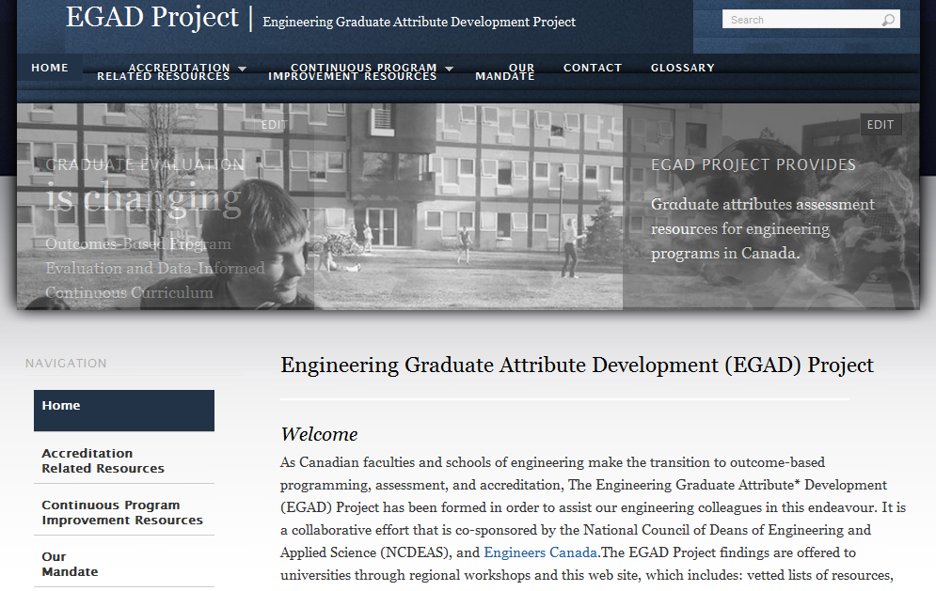
Online materials
http://egad.engineering.queensu.ca

Slide 74
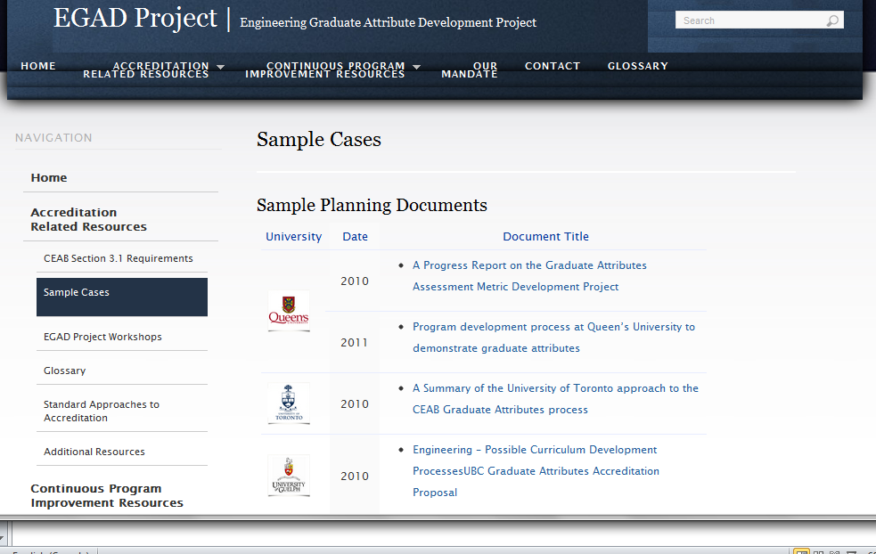
Online materials: samples
http://egad.engineering.queensu.ca

Slide 75
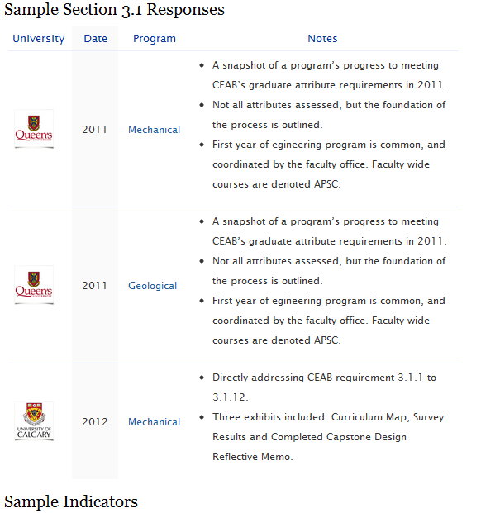
Online materials: Questionnaires
http://egad.engineering.queensu.ca

Slide 76
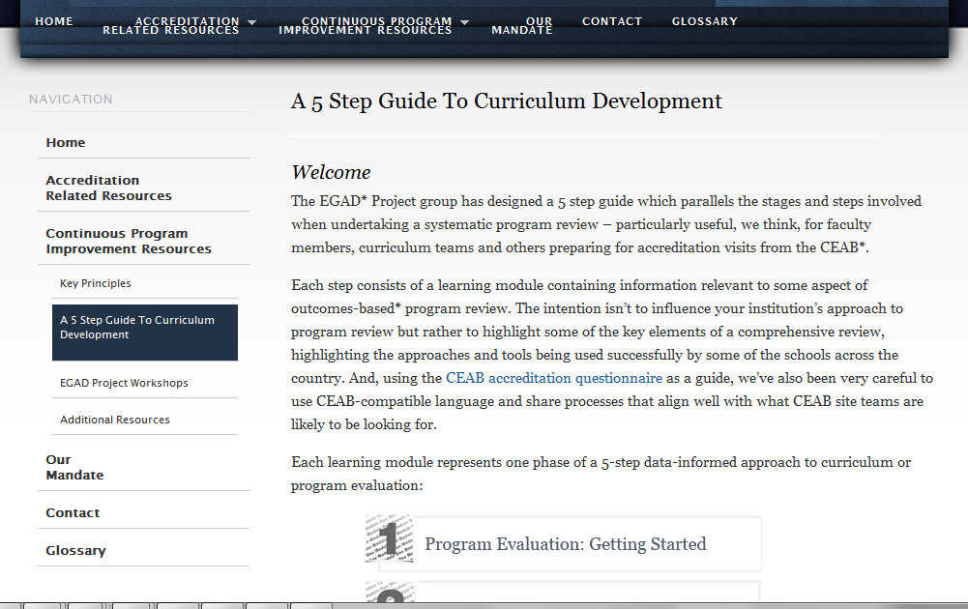
Online materials: training
http://egad.engineering.queensu.ca

Slide 77
Program visitors will be looking for evidence of progress towards:
Timing of data collection and analysis is clear, and continuous (cyclic).
Analysis is high quality and addresses the data
Improvement plan aligns with the analysis and data
Improvement plan is implemented

Slide 78
General advice - Revisited
Capitalize on what you're already doing: innovators, first adopters, experimenters
Start from the question “what do we want to know to improve our program”, rather than “what does CEAB want us to do” – think of this as self-directed learning!
Don't generate reams of data that you don't know what to do with: create information, not data
Dean/chair support can help encourage large scale curriculum development

Slide 79
Questions and discussion?

